Slide 1

Chapter Two (b)
SWE 421 - Game Development
Software Engineering Department
College of Engineering and Architecture
Al Yamamah University
Basics of HTML
Instructor: Layla Albabtain Fall 2019

Slide 2
Basic HTML - Links 01
Hypertext is the essence of the Web!
a link, acts as a pointer to some particular place in some Web resource
file name, a directory path and a file name, or a complete URL
A link is specified with the href (hypertext reference) attribute of <a> (the anchor tag)
The content of <a> is the visual link in the document
The anchor tag that specifies a link is called the source of that link.
The document whose address is specified in a link is called the target of that link.
<a href=”filepath/URL”> The visual link </a>

Slide 3
Example - Link
<!DOCTYPE html>
<html lang="en">
<head>
<title> Heading Examples </title>
<meta charset="UTF-8" />
</head>
<body>
<p> If you wish you link a webpage that is located in the same folder of the current page, add the webpage file name</p>
<a href="file.html"> file </a>
<p> if you wish to link a webpage that is in a seprate folder, add the name of the folder/file name </p>
<a href="webpages/file02.html"> file 02 </a>
<p> if you wish to link a webpage from another webpage use that webpage full URL </p>
<a href="https://www.w3schools.com/html/html_links.asp"> W3 Schools Links Tutorials </a>
</body>
</html>

Slide 4
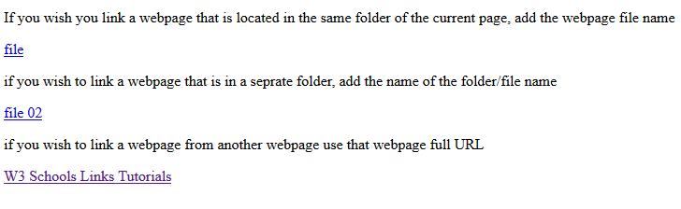
Example - Links

Slide 5
Basic HTML - Links 02
Links can be images.
The page that opens will open in the same tab/window as default.
Links can be set to open in a new tab/page.
The page that will open is referred to as target and it is an attribute of <a>.
The following are possible values of target:
_blank - Opens the linked document in a new window or tab
_self - Opens the linked document in the same window/tab as it was clicked (this is default).
<a href=“file.html” target=“_blank”> </a> ← open in a new tab or page
<a href=“file.html” target=“_self”> </a> ← open in the same page
<a href=“file.html”> </a> ← open in the same page.

Slide 6
Example - Links 02
<!DOCTYPE html>
<html lang="en">
<head>
<title> Links as Images Example</title>
<meta charset="UTF-8" />
</head>
<body>
<p> The following image can be clicked on </p>
<a href="https://www.w3schools.com/"><img src="icon.png" alt="This is the name of W3 Schools" /></a>
<p> This link will open in the same tab/window </p>
<a href="https://www.w3schools.com/"> W3 Schools </a>
<p> This link will also open in the same tab/window </p>
<a href="https://www.w3schools.com/" target="_self"> W3 Schools </a>
<p> This link will open in a new tab/window </p>
<a href="https://www.w3schools.com/" target="_blank"> W3 Schools </a>
</body>
</html>

Slide 7
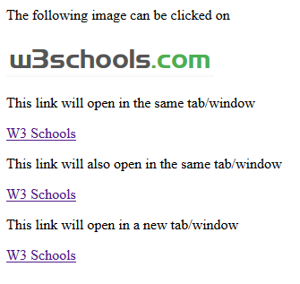
Example - 02

Slide 8
Basic HTML - Links 03 (Targets Within Document)
If the target is not at the beginning of the document, the target spot must be marked.
Target labels can be defined in many different tags with the id attribute, as in
<h1 id = "baskets"> Baskets </h1>
The link to an id must be preceded by a pound sign (#).
If the id is in the same document, this target could be.
<a href = "#baskets"> What about baskets? </a>
If the target is in a different document, the document reference must be included
<a href = "myAd.html#baskets”> Baskets </a>
Please refer to Links_Example.html in LMS.
For more about links.

Slide 9
Basic HTML - Lists
There are two types of lists, ordered lists (numbers) and unordered list (dots).
Ordered lists:
The list is the content of the <ol> tag.
<ol>
<li> items </li>
</ol>
List elements are the content of the <li> tag.
Unordered lists:
The list is the content of the <ul> tag.
List elements are the content of the <li> tag.
<ul>
<li> items </li>
</ul>

Slide 10
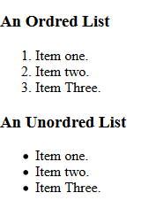
Example - Lists
<!DOCTYPE html>
<html lang="en">
<head>
<title> Lists Example </title>
<meta charset="UTF-8" />
</head>
<body>
<h3> An Ordred List </h3>
<ol>
<li> Item one. </li>
<li> Item two. </li>
<li> Item Three. </li>
</ol>
<h3> An Unordred List </h3>
<ul>
<li> Item one. </li>
<li> Item two. </li>
<li> Item Three. </li>
</ul>
</body>
</html>

Slide 11
Basic HTML - Nested Lists
Any type list can be nested inside any type list
list cannot be directly nested;
an <ol> tag cannot immediately follow an <ol> tag.
the nested list must be the content of an <li> element

Slide 12
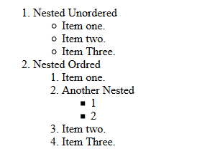
<body>
<h3> Nested Lists </h3>
<ol>
<li> Nested Unordered
<ul>
<li> Item one. </li>
<li> Item two. </li>
<li> Item Three. </li>
</ul>
</li>
<li> Nested Ordred
<ol>
<li> Item one. </li>
<li> Another Nested
<ul>
<li> 1 </li>
<li> 2 </li>
</ul>
</li>
<li> Item two. </li>
<li> Item Three. </li>
</ol>
</li>
</ol>

Slide 13
Basic HTML - Description lists (for glossaries, etc.)
Specify lists of terms and their definitions, as in glossaries.
Each term to be defined in the definition list is given as the content of a <dt> tag.
The definitions themselves are specified as the content of <dd> tags.
More about Lists.

Slide 14
Example - Description Lists
<!DOCTYPE html>
<html lang="en">
<head>
<title> Lists Example </title>
<meta charset="UTF-8" />
</head>
<body>
<h3> Description Lists </h3>
<dl>
<dt> Games </dt>
<dd> games are fun challenging activties that follows a set of rules </dd>
<dt> Video Games </dt>
<dd> Video games are games which are played on PC or Consoles and other devices. </dd>
<dd> They became popular and generates huge revenue every year </dd>
</dl>
</body>
</html>

Slide 15
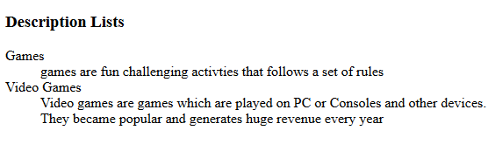
Example - Description Lists

Slide 16
Basic HTML - Tables 01
A table is a matrix of cells, each possibly having content.
The cells in the top row often contain column labels.
Cells in the leftmost column often contain row labels, and most of the rest of the cells contain the data of the table.
The cells can include almost any element
A table is specified as the content of a <table> tag.
Tables are given titles with the <caption> tag, which can immediately follow <table>.
Please refer to Table examples in lms.

Slide 17
Basic HTML - Tables 02
There are two kinds of lines in tables:
border : the line around the outside of the whole table
rules : the lines that separate the cells from each other.
A table that does not include the border attribute will be a matrix of cells with neither a border nor rules.
The browser has default widths for table borders and rules,
a number can be given as border’s value, which specifies the border width in pixels.
For example, border = “3” specifies a border 3 pixels wide.
A border value of “0” specifies no border and no rules.

Slide 18
Basic HTML - Tables 03
The cells of a table are specified one row at a time.
Each row of a table is specified with a row tag, <tr>.
Within each row, the row label is specified by the table heading tag, <th>.
Each data cell of a row is specified with a table data tag, <td>.
The first row of a table usually has the table’s column labels <th>.
For example, if a table has three data columns and their column labels are, respectively, Name, Phone, and Address, the first row can be specified by the following:
<table>
<tr>
<td> Apple </td>
<td> Orange </td>
<td> Screwdriver </td>
</tr>
</table>

Slide 19
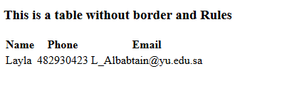
<!DOCTYPE html>
<html lang="en">
<head>
<title> Lists Example </title>
<meta charset="UTF-8" />
</head>
<body>
<h3> This is a table without border and Rules </h3>
<table>
<tr>
<th>Name</th>
<th>Phone</th> <th>Email</th>
</tr>
<tr>
<td>Layla</td>
<td>482930423</td>
<td>L_Albabtain@yu.edu.sa</td>
</tr>
</table>
</body>
</html>

Slide 20
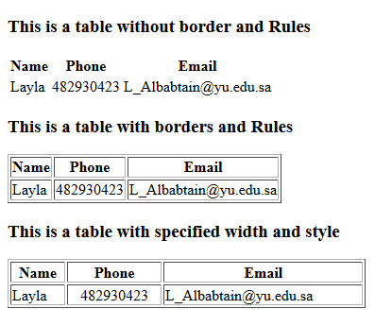
Example - Tables

Slide 21
Basic HTML - Tables 03
<tr>
<th>Name</th>
<th colspan="2">Phone</th>
</tr>
<tr>
<td>Layla</td>
<td>482930423</td>
<td>234234234</td>
</tr>
Table has rowspan and colspan as Attributes.
A table can have two levels of column labels.
colspan attribute must be set in the <th> tag to specify that the label must span some number of columns.
Please refer to Tables Examples in LMS
<tr>
<th>Name</th>
<td>Layla</td>
</tr>
<tr>
<th rowspan="2">Phone</th>
<td>482930423</td>
</tr>
<tr>
<td>234234234</td>
</tr>

Slide 22
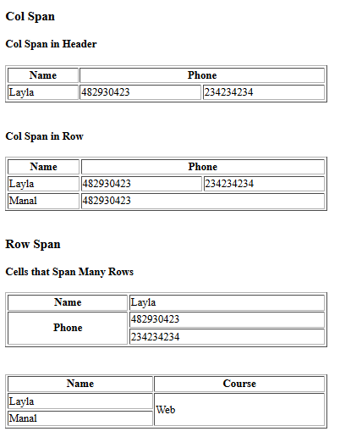
Example - Tables 03

Slide 23
Basic HTML - Tables 04
We can add a caption using <caption> tag.
Table groups:
<thead> Groups the header content in a table
<tbody> Groups the body content in a table
<tfoot> Groups the footer content in a table
Why use table groups:
Browsers can use these elements to enable scrolling of the table body independently of the header and footer.
Also, when printing a large table that spans multiple pages, these elements can enable the table header and footer to be printed at the top and bottom of each page.
Please refer to Table Examples on LMS.

Slide 24
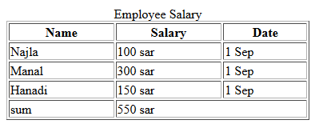
Example - Table 04

Slide 25
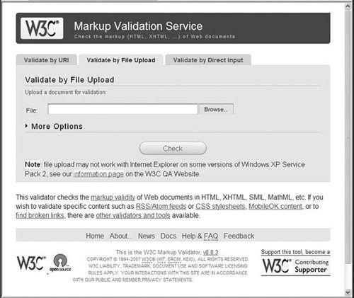
HTML Validation
The W3C provides a convenient Web-based way to validate HTML documents against its standards.
The validator can be found in this link.
The validation can be done by providing a website URL, uploading an html file or pasting the HTML directly.

Slide 26
Resources
W3 School.

